Slide 1
Knowledge
Transfer
@CERN
Giovanni Anelli
Head of Knowledge Transfer Group

Slide 2
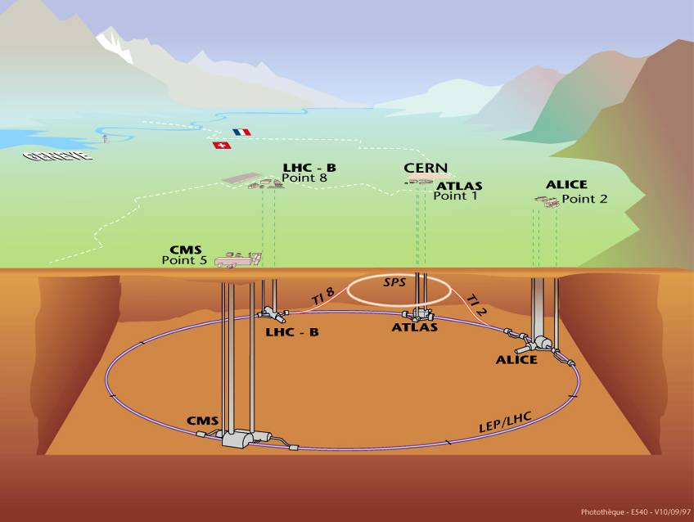
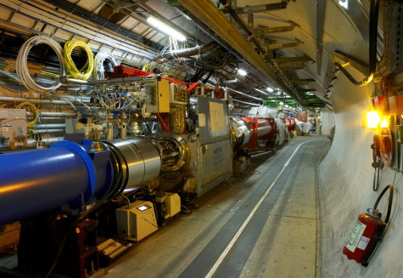
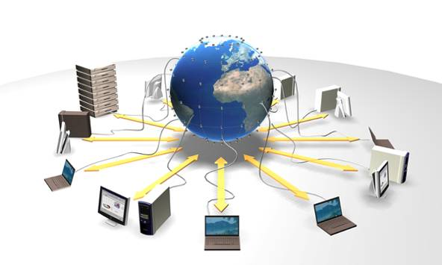
CERN Technologies
CERN innovates in three areas
Detecting
particles
Accelerating
particle beams
Large-scale computing (Grid)

Slide 3
Accelerator Technologies
Base Technologies: LHC
Superconductivity
(12kA)
Cryogenics
(1.9 K)
Vacuum
(10⁻¹³ atm)
Magnets
(8 T)

Slide 4
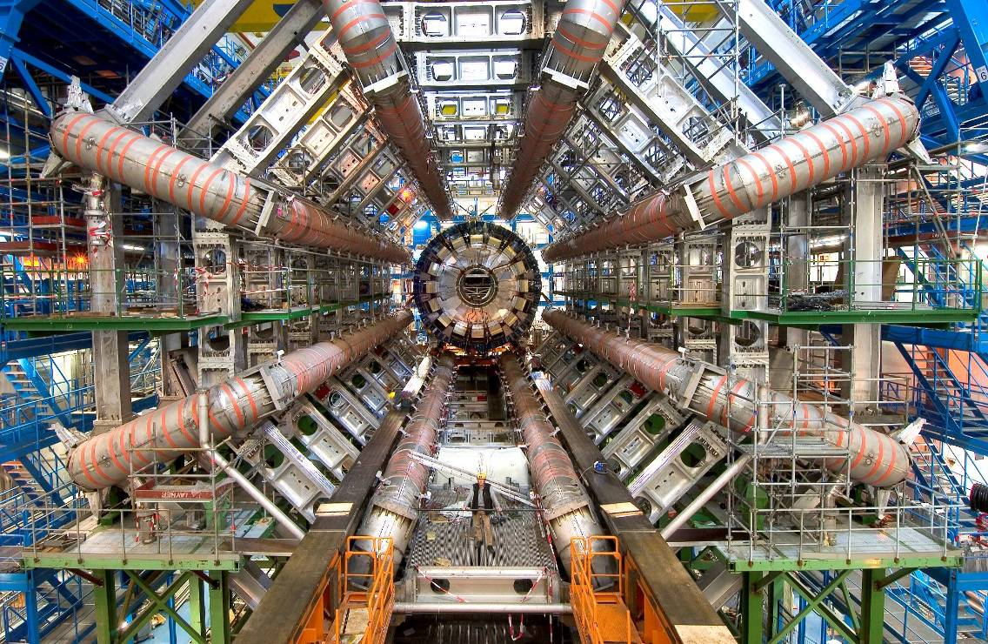
Detector Technologies
Challenge: sample the results of up to 600
million proton-proton collisions per second!
LHC detectors have sophisticated electronic trigger systems that precisely measure the passage time of a particle to accuracies in the region of a few billionths of a second. The trigger system also registers the location of the particles to millionths of a metre. This is essential for ensuring that the particle recorded in successive layers of a detector is one and the same.

Slide 5
Computing Technologies: the Grid
After filtering, CERN detectors select ~200 interesting
collisions per second.
Several MBs of data to be stored for each collision...
more than 20 Petabytes/year of data!
8 Megabyte (8MB)
A digital photo
1 Gigabyte (1GB)
= 1000MB
A DVD movie
1 Terabyte (1TB)
= 1000GB
World annual
book production
15 Petabytes (15PB)
= 15000TB
Annual LHC data output
CERN, home of the World Wide Web, is a driving force
in Grid Computing

Slide 6
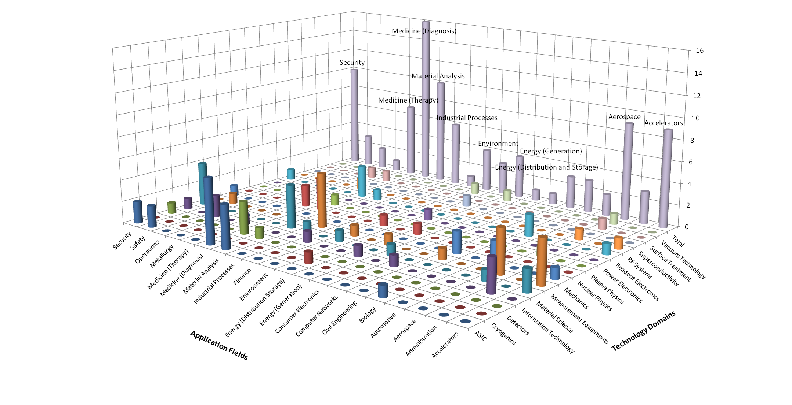
CERN’s Technology Portfolio

Slide 7
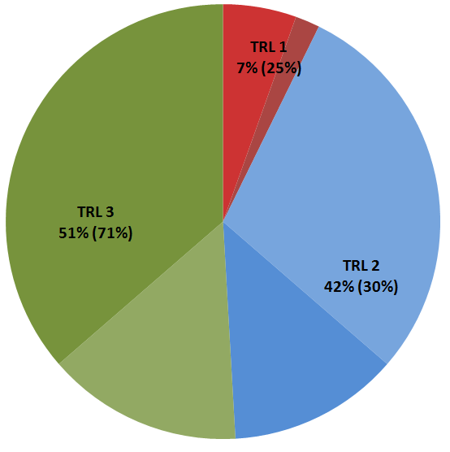
Technology Portfolio - statistics
Technology Portfolio - General Statistics
~200 TT cases (30% open, 20% protected by patent)
  ~10 new disclosures per year
  Exploitation level: ~50%
TRL | Simplified Definition
1 | Technology application formulated and basic concept demonstrated
2 | Functional validation in laboratory environment
3 | Representative prototype fully qualified (technology ready to transfer)

Slide 8
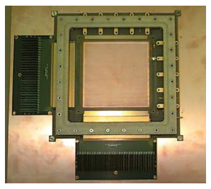
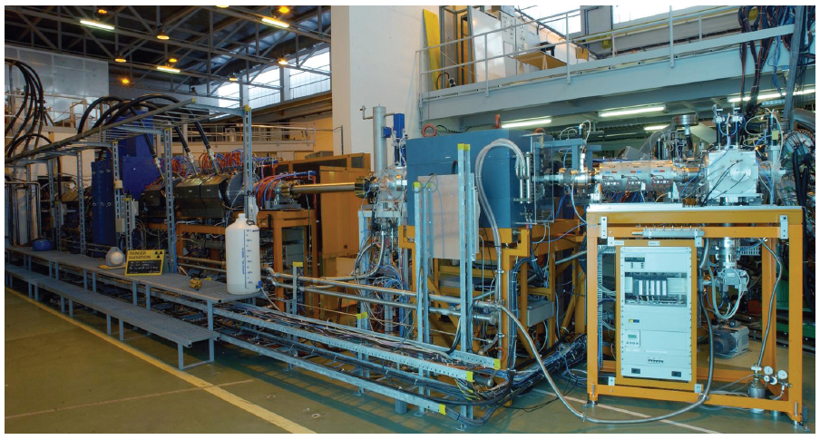
KT Fund
Funding Innovation
The KT Fund is a financial instrument which helps bridging the gap between CERN and society
The requests are evaluated by a Committee composed by all the Department Heads and members of the KT Group
The 6 projects submitted in 2011 were all judged excellent by the committee and financed

Slide 9

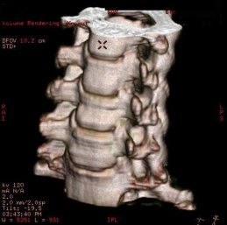
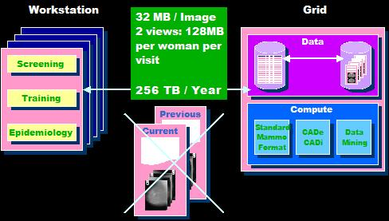
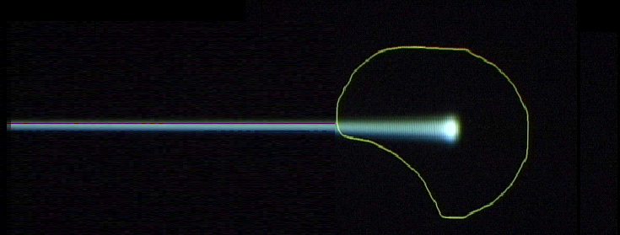
Medical applications
Particle accelerators for hadron therapy
Particle detector for medical imaging
Grid computing for medical data management and analysis
Tumour
Target
Charged hadron beam
that loses energy in matter

Slide 10
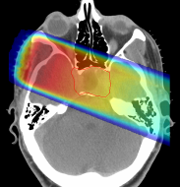
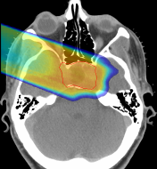

Hadron Therapy
28 cm
tumour
target
200 MeV
protons
charged hadron beam
that loses energy in matter
X rays
protons or
carbon ions
Hadron beams provide new treatment opportunities for
deep-seated tumours.
Hadron beams are more effective than X-rays in destroying tumours
while sparing healthy tissues nearby.
Photons
Protons
GSI

Slide 11
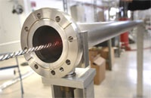
From high vacuum…
NEG (Non-Evaporable Getter thin film coatings)
Technology used to create and maintain ultra-high vacuum in the accelerator vacuum chambers.

Slide 12
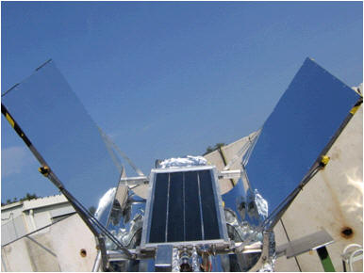
… to solar energy!
License and partnership with a start-up company
Development of a commercial product able to use diffused or indirect light and reach very high temperatures of up to 300 degrees
Development of a prototype production chain

Slide 13
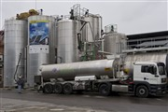
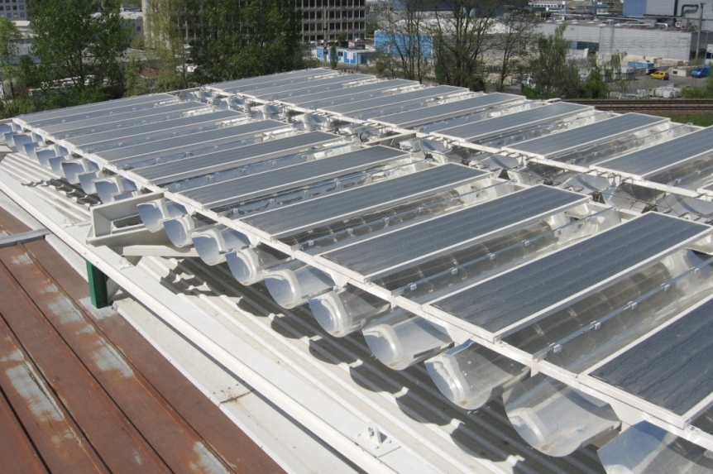
Solar panels plant
Civil-engineering company opened a new solar power plant
Environmentally friendly "solar field" heats close to 80,000 cubic metres of bitumen to 180 degrees.

Slide 14
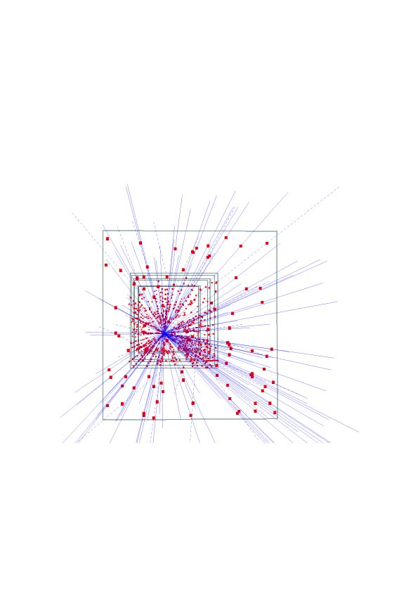
Silicon pixel detectors (SPDs)
Hybrid silicon pixel detectors for tracking applications in High Energy Physics
153 high energy particle tracks flying through a telescope of half a million pixels in the WA97 experiment back in 1995

Slide 15
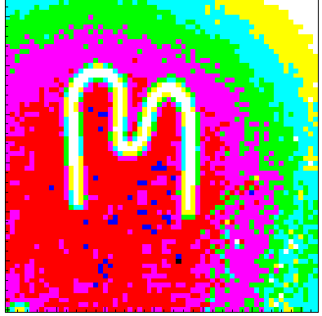
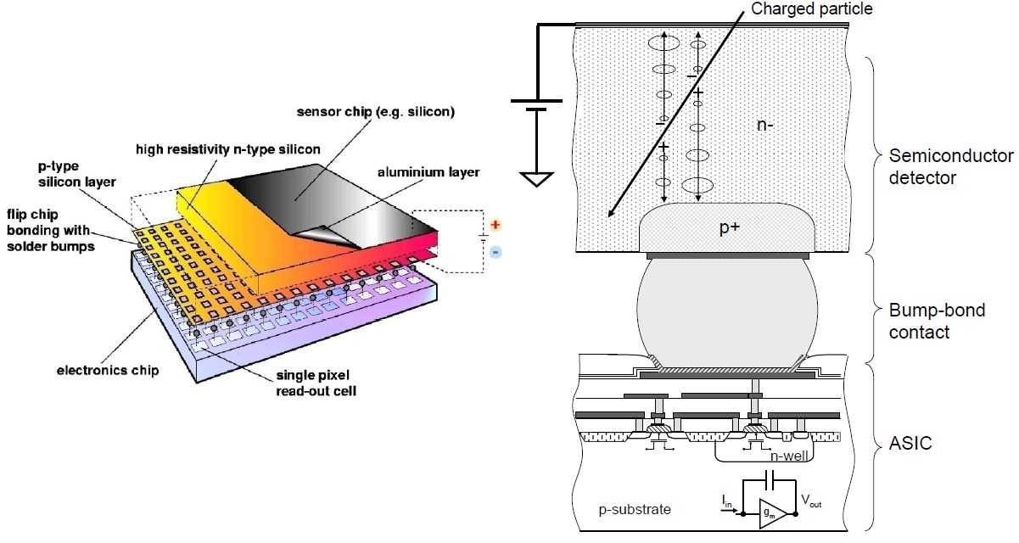
Medipix
Medipix 2 collaboration
  17 institutes and labs

Slide 16
Medipix
A family of single photon counting integrated circuits used in Hybrid Silicon Pixel Detectors
The Medipix collaborations (close to 20 institutes) contributed to the development and dissemination of the technology
A good example of how (fundamental) science fosters innovation which can be transferred to society… and back!

Slide 17
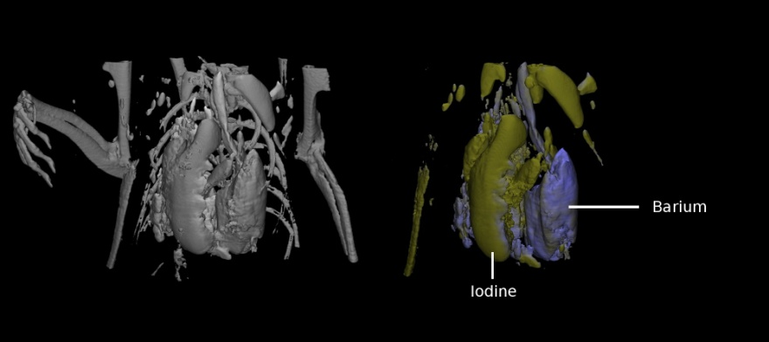
Application: Medical imaging
MARS project
  Colour CT X-ray scanner based on the Medipix technology
(courtesy of MARS Bioimaging Ltd)

Slide 18
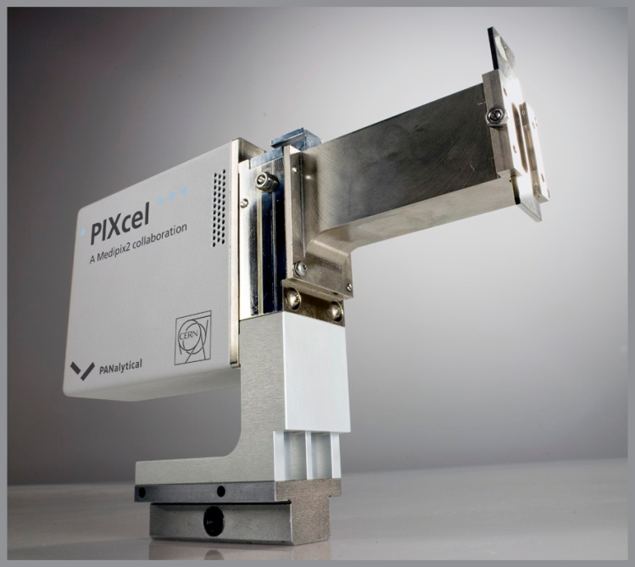
Application: Material analysis
Partnership and license agreements with a company to build a X-ray diffractometer

Slide 19
Other ways of dissemination
The Technology Transfer process:
invention disclosure → IP protection → license to a company
is difficult, especially for the world of particle physics. Collaborative R&D (with industry and other research institutes) is key for a successful transfer.
Other ways of dissemination are also very important for the Organization

Slide 20
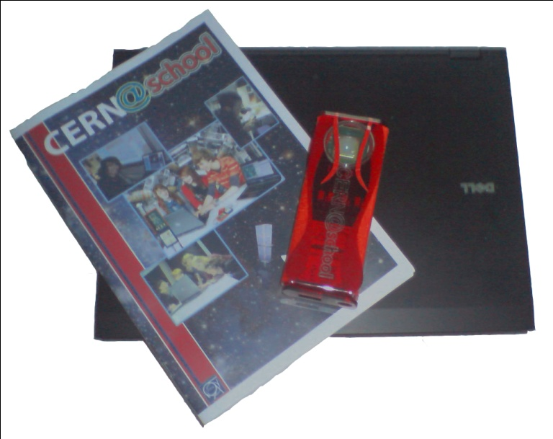
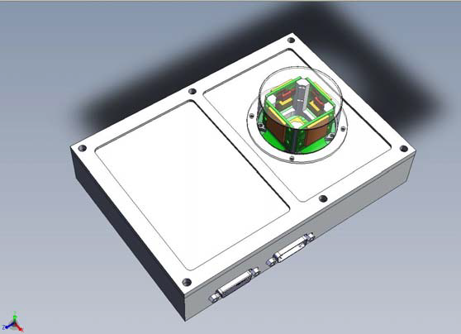

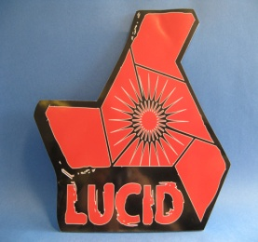
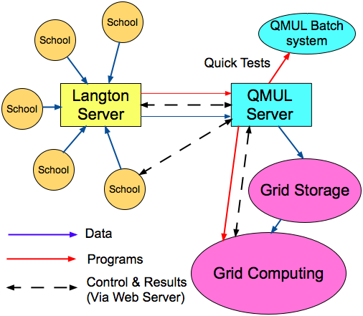
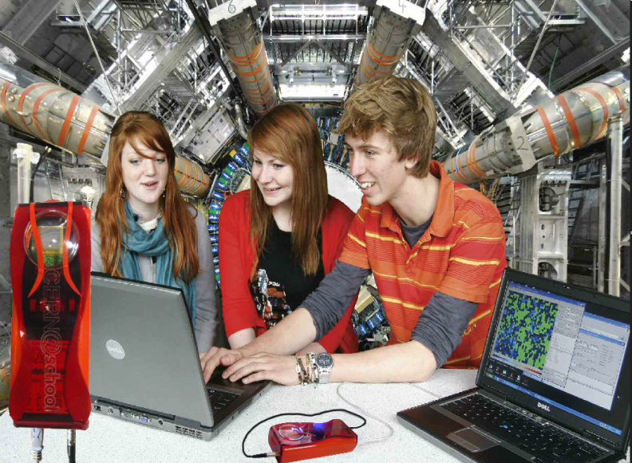
Langton Ultimate Cosmic ray Intensity Detector uses 5 Timepix chips to monitor the radiation environment in Space
CERN@school allows students to use a Timepix chip in the lab to visualise radiation
Data from LUCID and CERN@school detectors will be uploaded to the Grid and made available for students to analyse

Slide 21
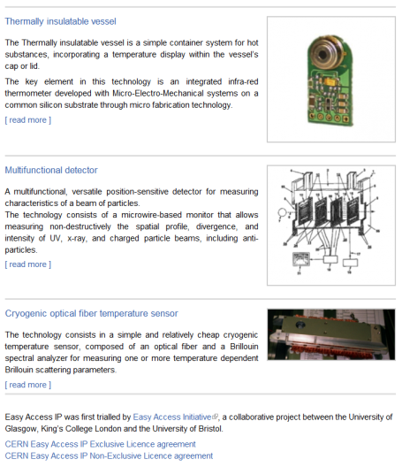
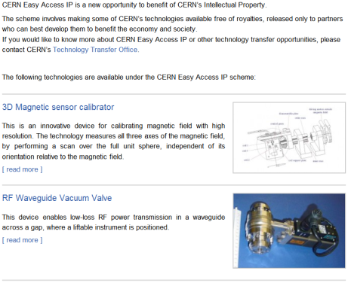
CERN Easy Access IP
Notes:
This is a screenshot of our website.
We have implemented the scheme pioneered by the University of Glasgow. We are ready to give a free license (for some of our technologies) to companies who will demonstrate that they can turn it into a product.

Slide 22

CERN Open Hardware Licence
A legal framework to facilitate knowledge exchange across the electronic design community.
In the spirit of knowledge and technology dissemination, the CERN OHL was created to govern the use, copying, modification and distribution of hardware design documentation, and the manufacture and distribution of products.

Slide 23
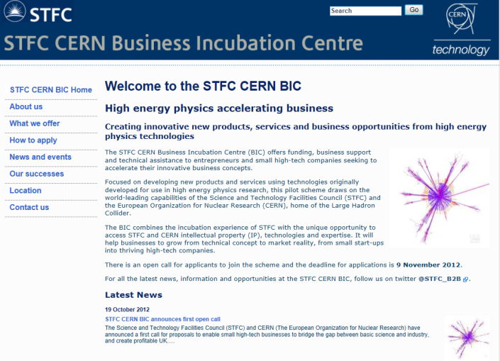
http://www.stfc-cern-bic.org.uk
Notes:
Screenshot of the new website for the CERN BIC. The first open call went live on Friday the 19th of October.

Slide 24
Incubators in the MS
The STFC CERN BIC is a pilot scheme we would like to replicate in other Member States
Integration into existing structures is crucial
To “fill” these incubators, we are working on a “pre-incubator” concept at CERN: CERN technologies + (external) fundings + (external) entrepreneurs → new companies generation

Slide 25





European Knowledge Transfer Networks
Forum for European Intergovernmental Research Organisations
EEN, Enterprise Europe Network
TTN, Technology Transfer Network
TTO Circle - European Technology Transfer Offices Circle
The European Network for LIGht ion Hadron Therapy

Slide 26
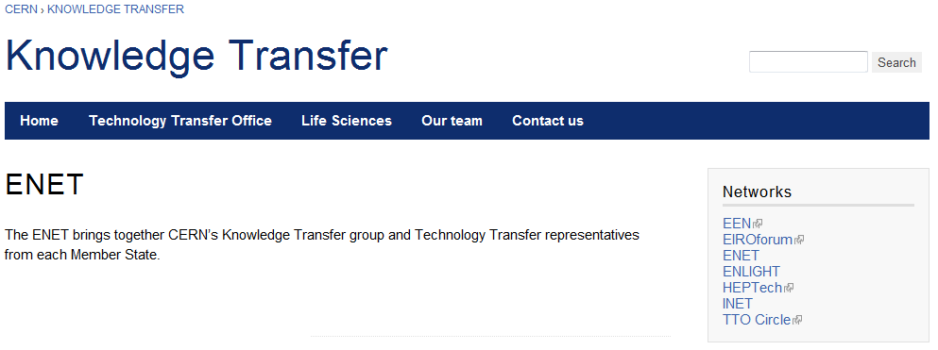

ENET

Slide 27
Knowledge Transfer through Procurement
Results from a survey of companies involved in technology-intensive
procurement contracts with CERN.
178 questionnaires analyzed, related to 503 MCHF procurement
budget.
Results:
44% indicated technological learning
42% increased their international exposure
38% developed new products
36% indicated market learning
13% started new R&D teams
52% would have had poorer sales performance without CERN
41% would have had poorer technological performance

Slide 28
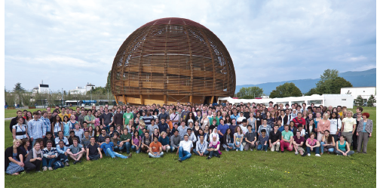
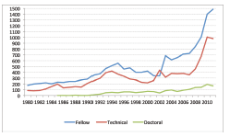
Knowledge Transfer through People
Every year, hundreds of students come to CERN to contribute to our research programs
An opportunity for young people to learn in a multicultural environment
Not only for physicists! Also engineers, computer scientists, administrative students…

Slide 29





EU funded projects
Wide range of hadron therapy projects: training, R&D, infrastructures
A total funding of ~24 M Euros
All coordinated by CERN, except ULICE coordinated by CNAO
Under the umbrella of ENLIGHT
Marie Curie Initial Training Network
12 institutions
25 trainees (4 CERN fellows)
PARTNER-2 submitted in 2011
Infrastructures for hadron therapy
20 institutions
Mid term review in 2011
R&D on medical imaging for hadron therapy
16 institutions
Preparation of the mid term review in 2011
Marie Curie ITN
12 institutions
16 trainees (3 CERN fellows)
Kick-off in 2011

Slide 30

Physics for Health in Europe
First workshop on physics
for health applications @ CERN
review the progress in the domain of physics applications for health
identify the most promising areas for further developments
explore synergies between physics and physics spin-offs
catalyse dialogue between doctors, physicists, medical physicists……

Slide 31
3 CERN Initiatives arising from PHE2010
Biomedical Facility
  creation of a facility at CERN that provides particle beams of different types and energies to external users interested in radiobiology and detector development
Medical Accelerator Design
  coordinate an international collaboration to design a new low-cost accelerator facility, which would use the most advanced technologies
Radio Isotopes
  Set up a European user facility to supply innovative radioisotopes (produced at ISOLDE-CERN, ILL, PSI, Arronax,...) for R&D in life sciences (preclinical and clinical studies)

Slide 32

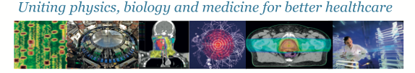
International Conference on Translational Research in Radio-Oncology
Physics for Health in Europe
&
February 27 – March 2, 2012 at CICG, Geneva
  2 days devoted to physics, 2 days to medicine, 1 day of overlapping topics
Over 500 people registered, nearly 400 Abstract
http://cern.ch/ICTR-PHE12

Slide 33
Summary of Knowledge Transfer Modes
Licensing of intellectual property and consulting
Joint R&D with external partners (Industry !)
Start-up companies creation
Open Hardware License and similar initiatives
CERN training programs and personnel mobility
Procurement activities
Networking and catalyzing knowledge exchange (multidisciplinary events)

Slide 34
Conclusions
CERN regards knowledge and technology transfer as an integral part
of its mission.
CERN technologies have applications in several domains with high
relevance to society. In particular, CERN has been providing a significant
contribution to innovation in medical sciences over the last 10-15 years.
By making an impact on key application domains we aim to illustrate the
role of fundamental research as a driver of innovation which delivers
tangible benefits to mankind.
CERN’s technical departments have unique knowledge and skills. We are
keen to collaborating with industry and to investigate how our know-how
can be used to satisfy industry needs.
We have a lot to offer to industry – please get in touch!

Slide 35
More info / Contacts
www.cern.ch/knowledgetransfer
giovanni.anelli@cern.ch
mail-KT@cern.ch

